Slide 1


Slide 2
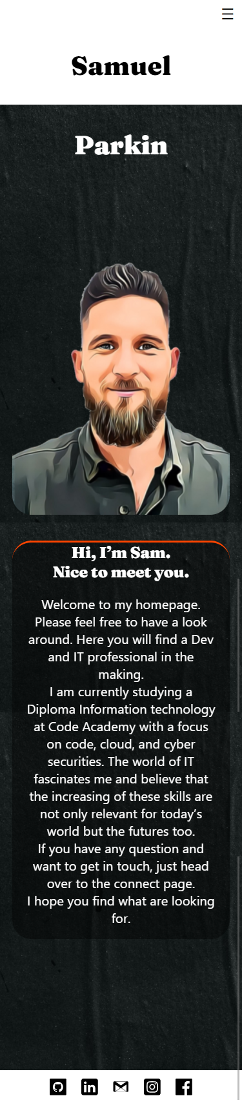
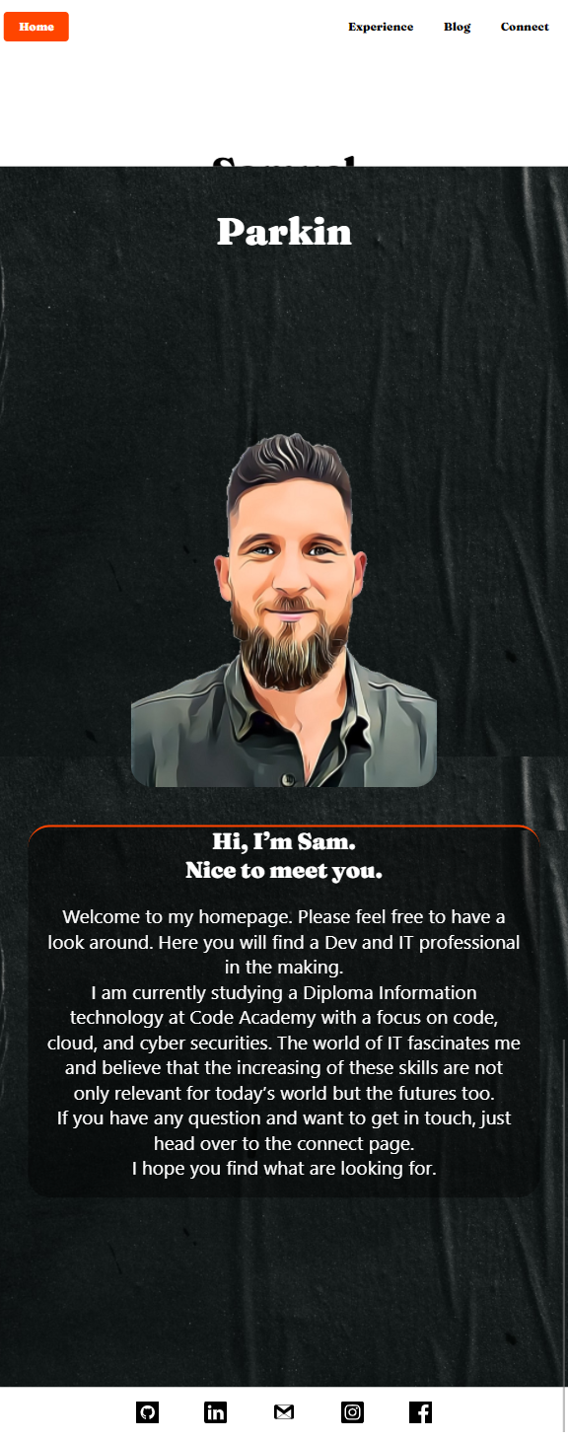
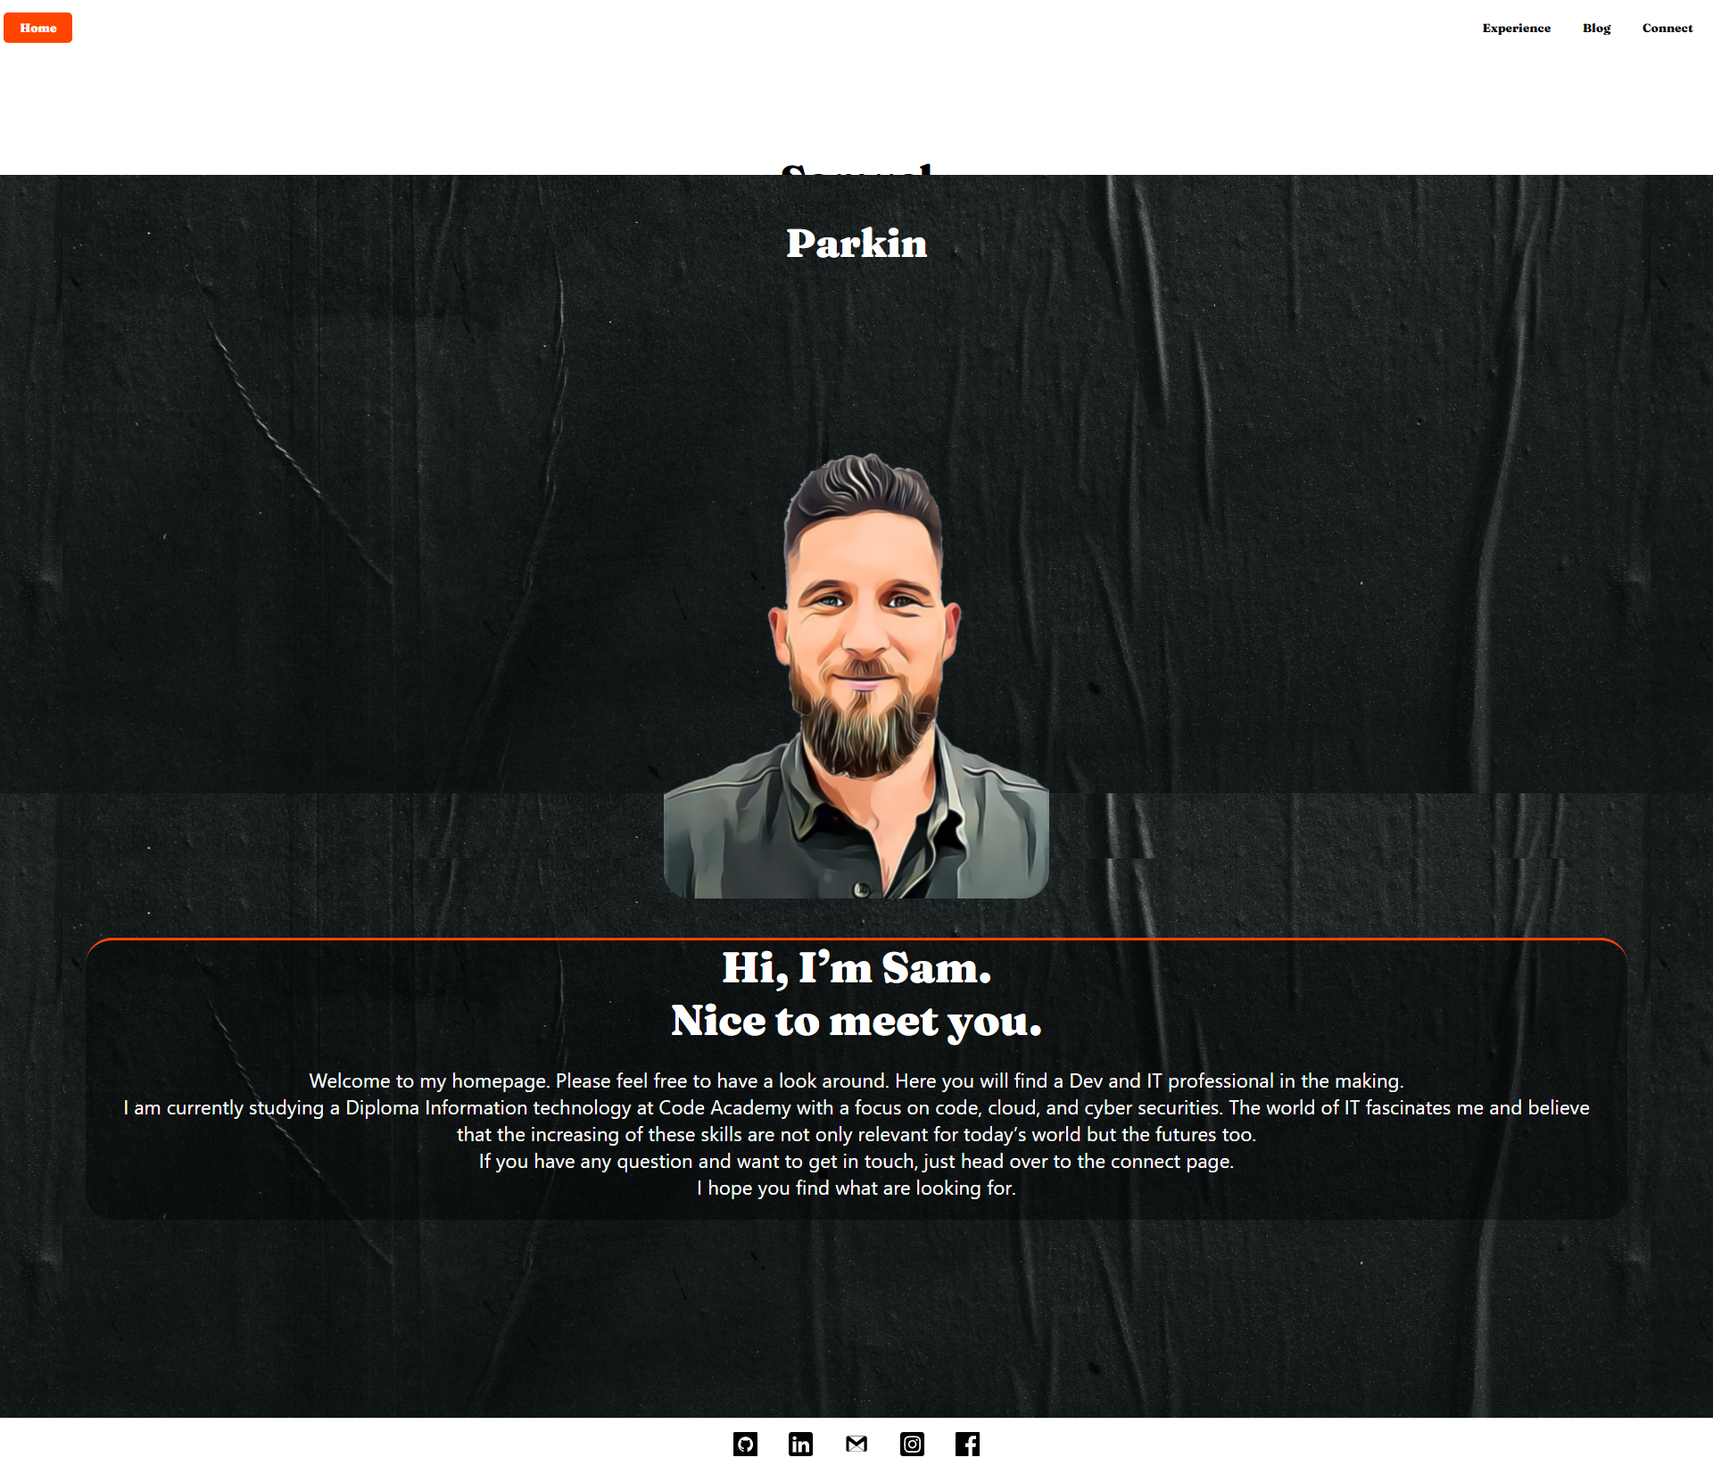
Portfolio Home Page

Slide 3
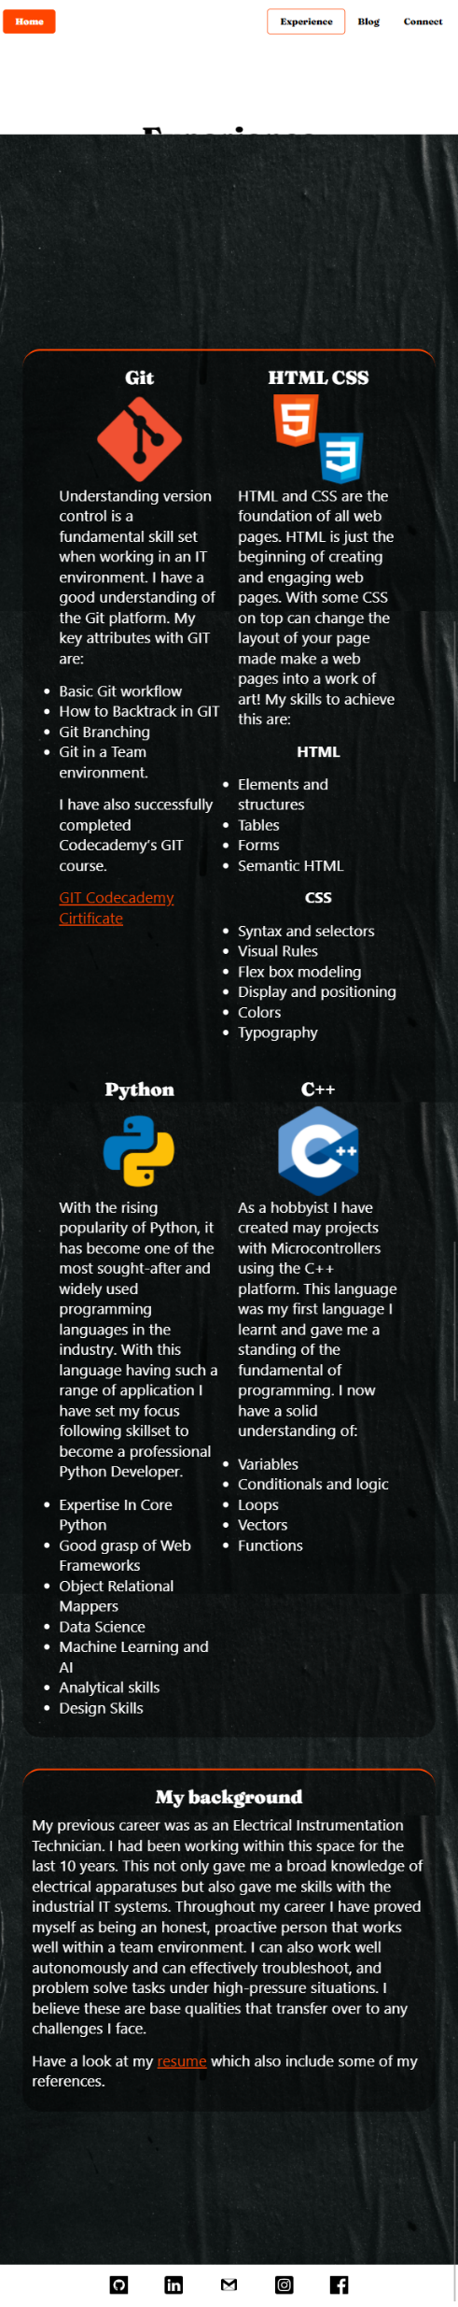
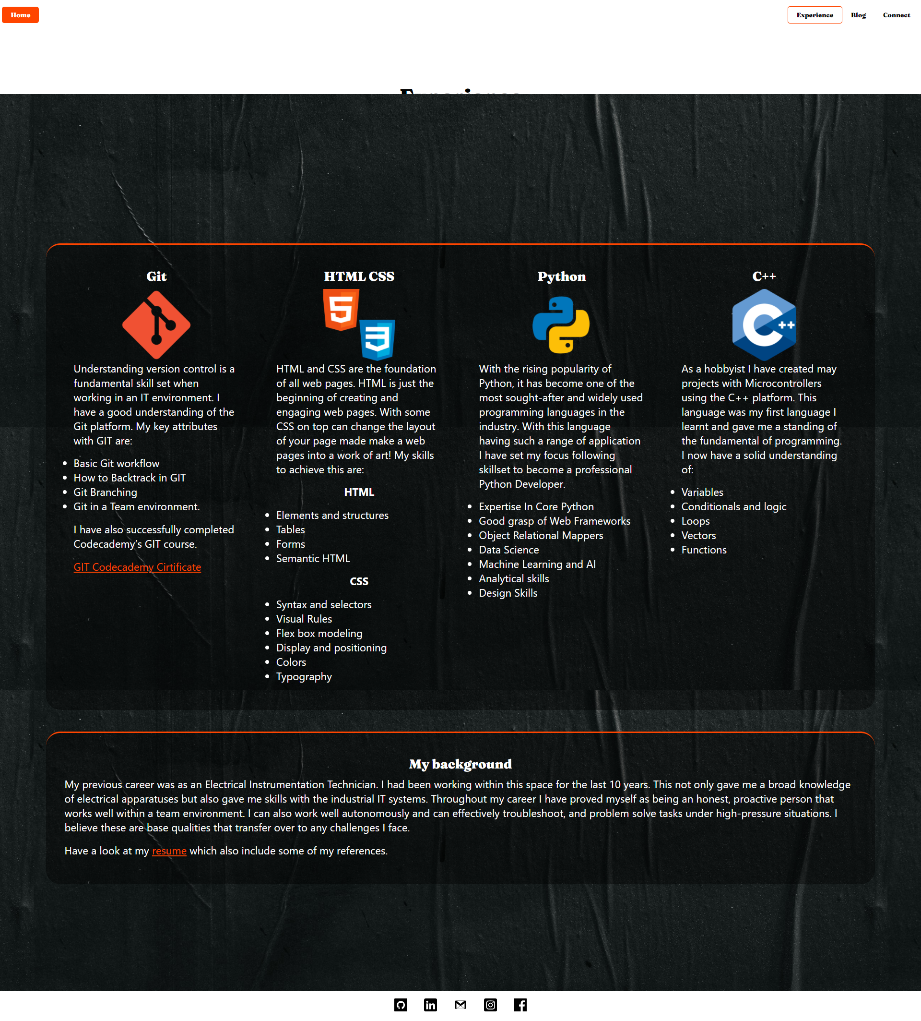
Portfolio Experience Page

Slide 4
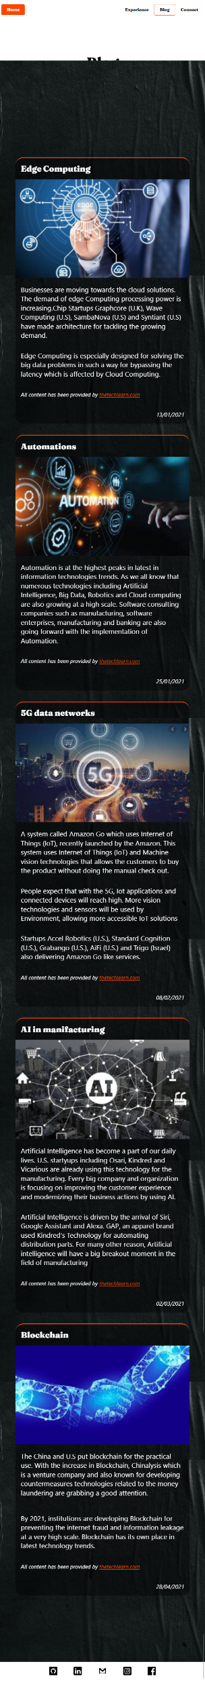
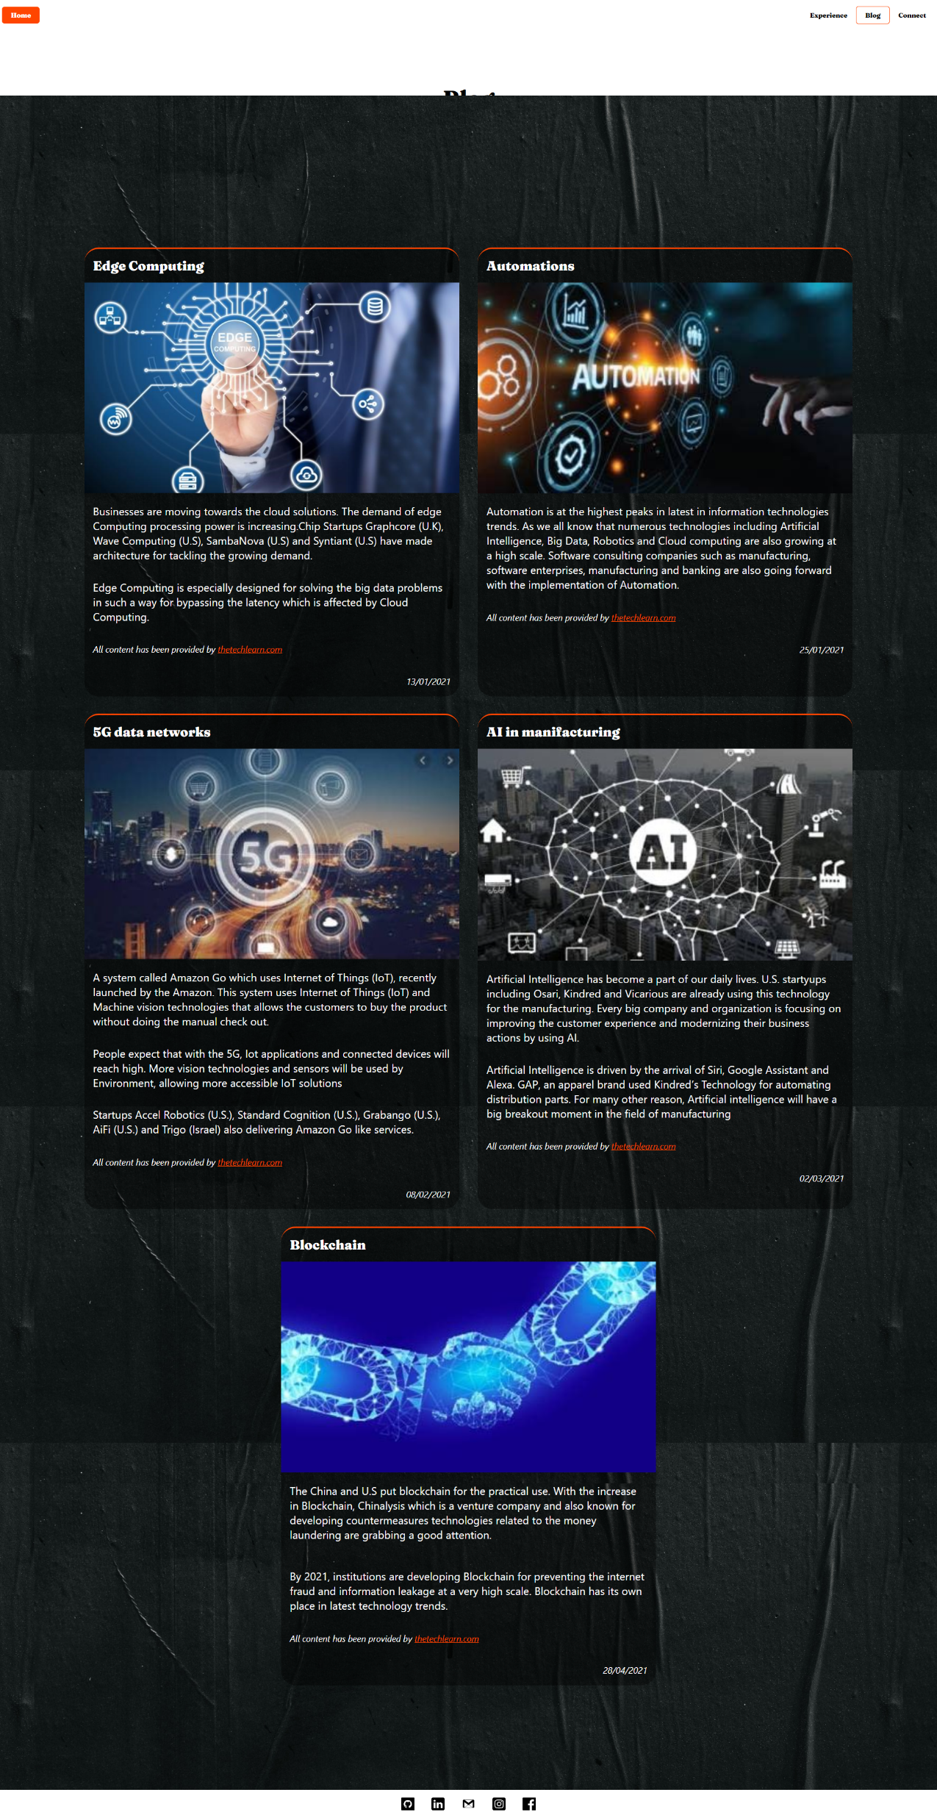
Portfolio Blog Page

Slide 5
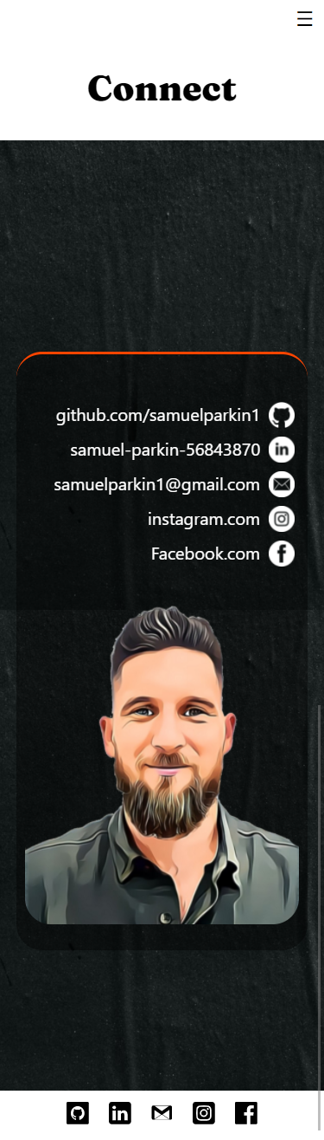
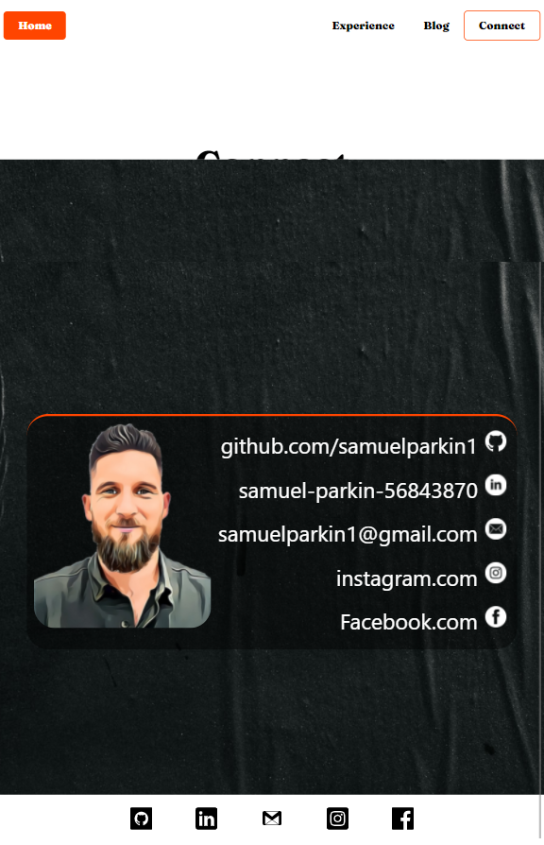
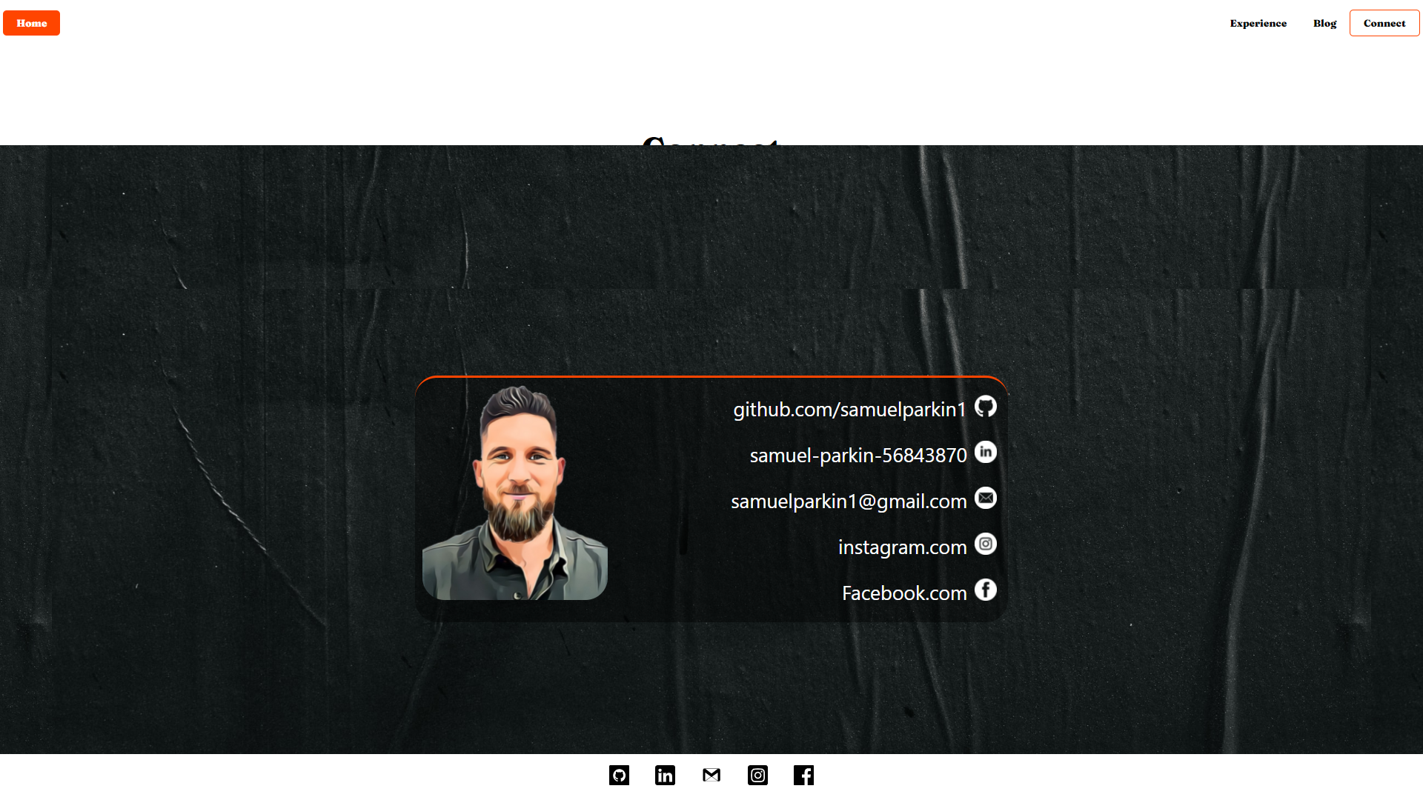
Portfolio Connect Page

Slide 6
Design process and decisions
The page was to have a minimalist feel to it.
Inspiration was taken from Youi insurance and Balter Brewery

Slide 7
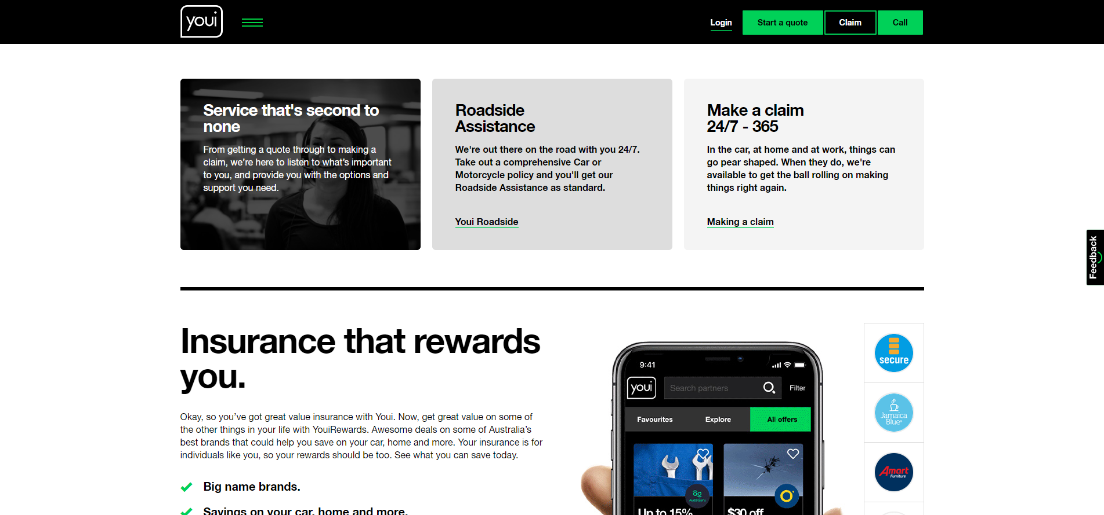
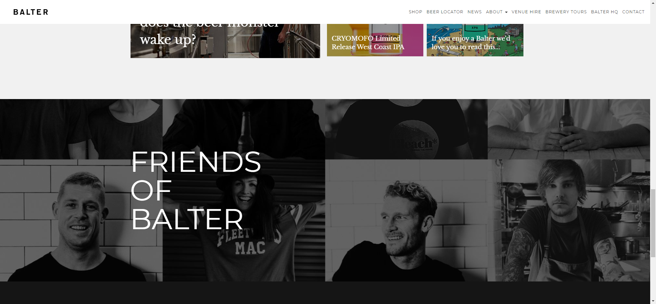
Inspirations

Slide 8
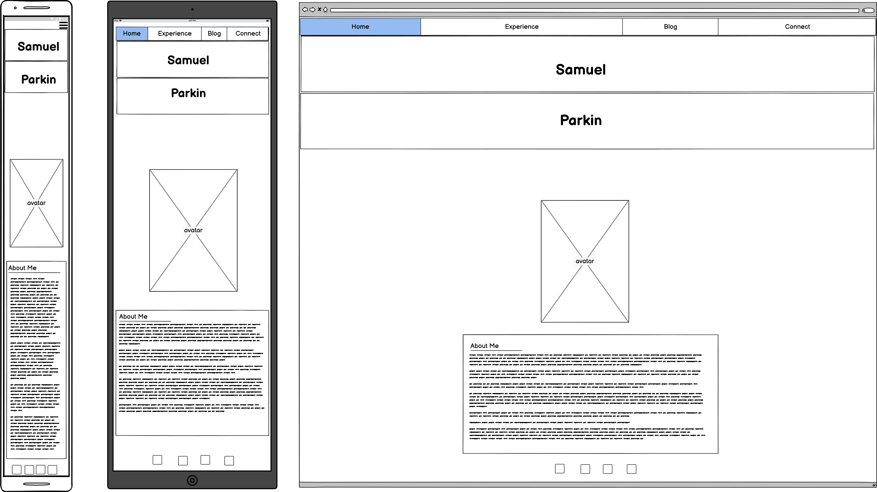
Wireframe of Home Page

Slide 9
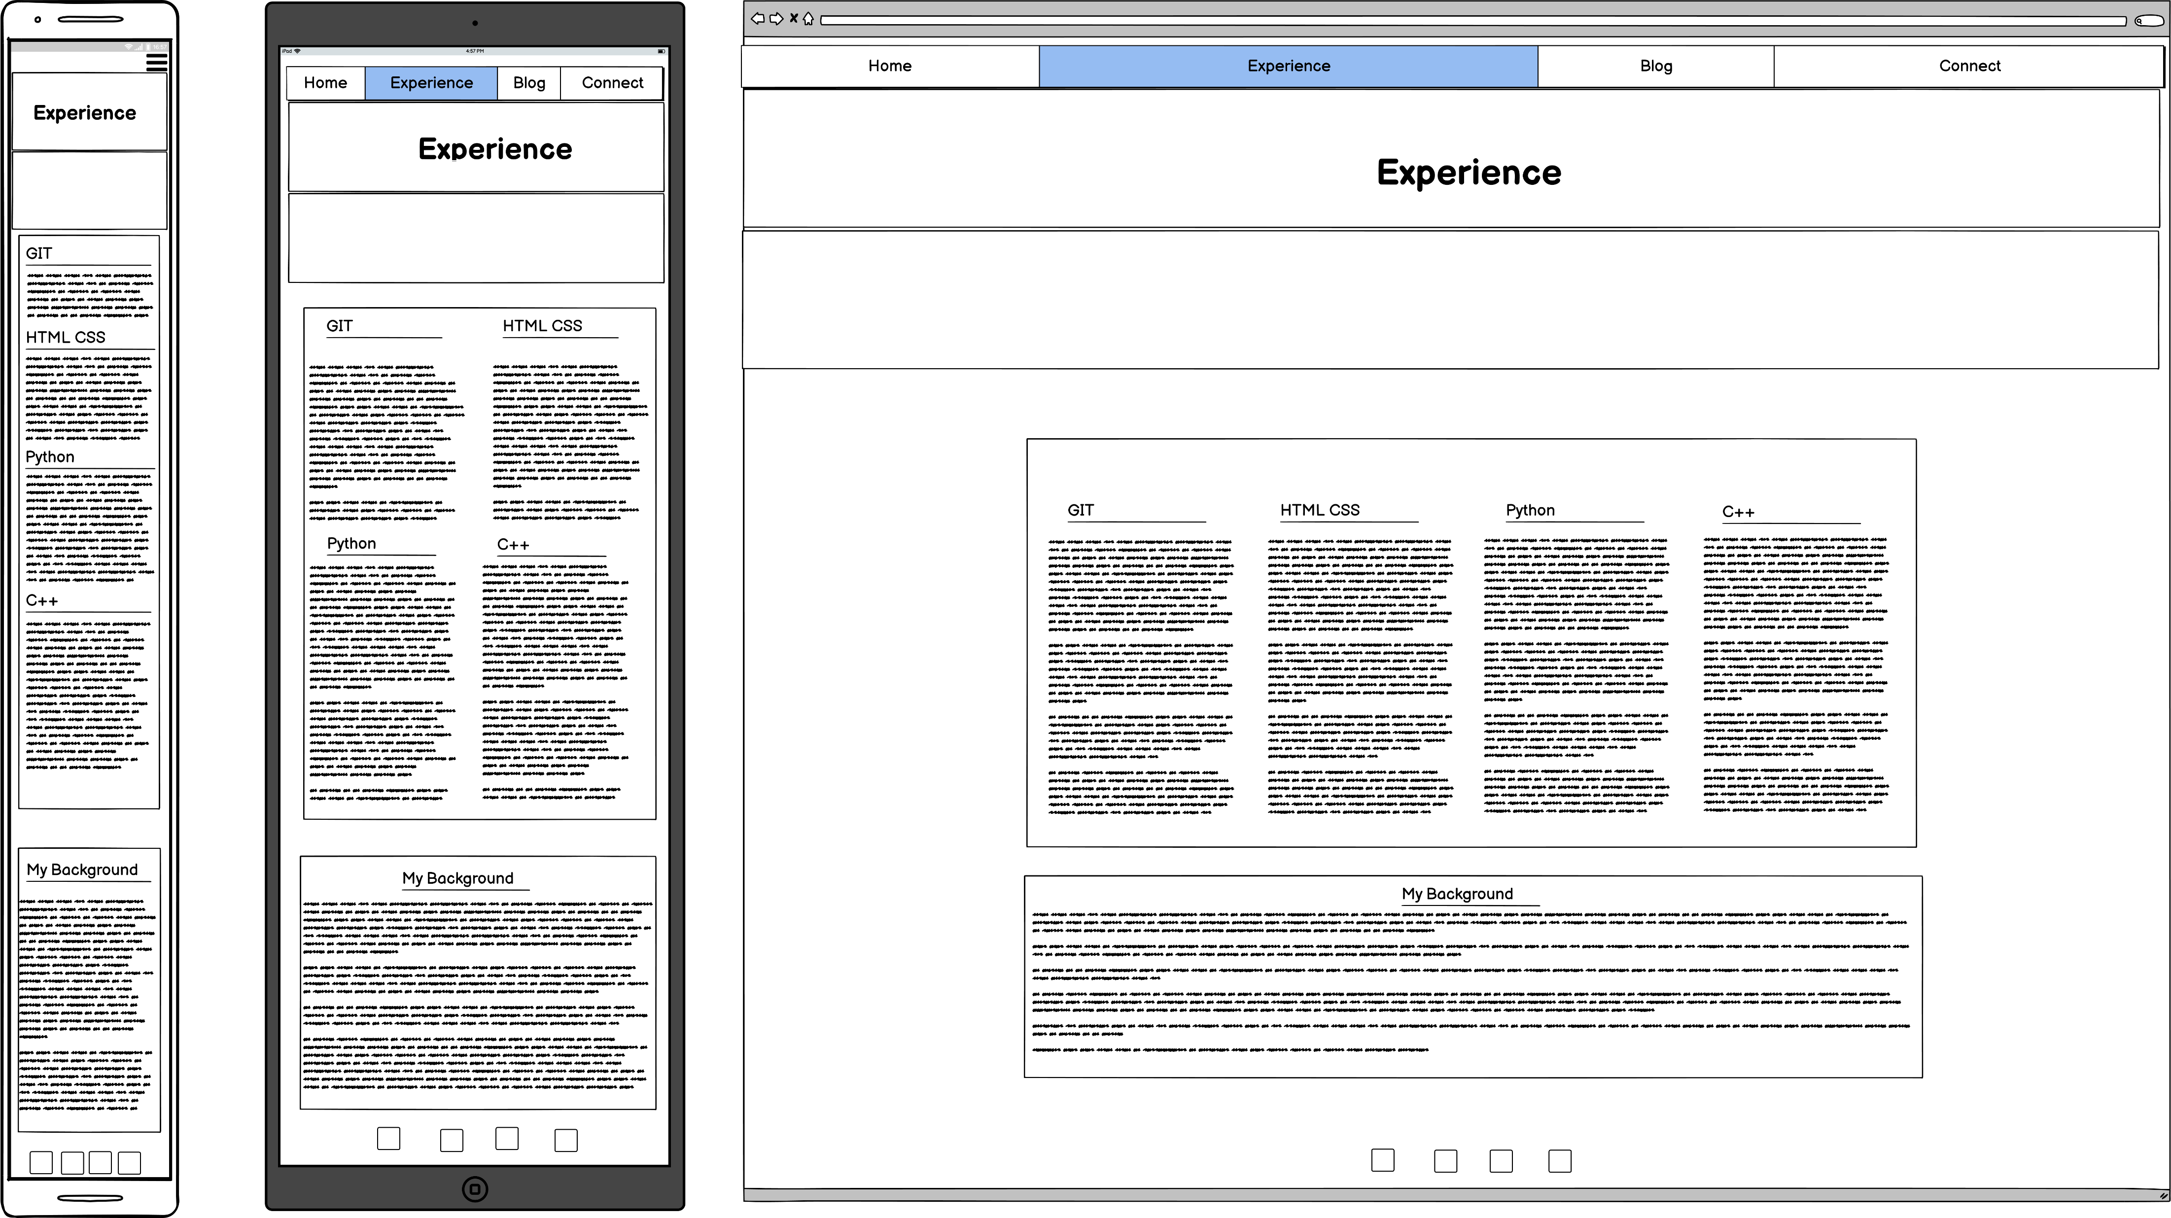
Wireframe of Experience Page

Slide 10
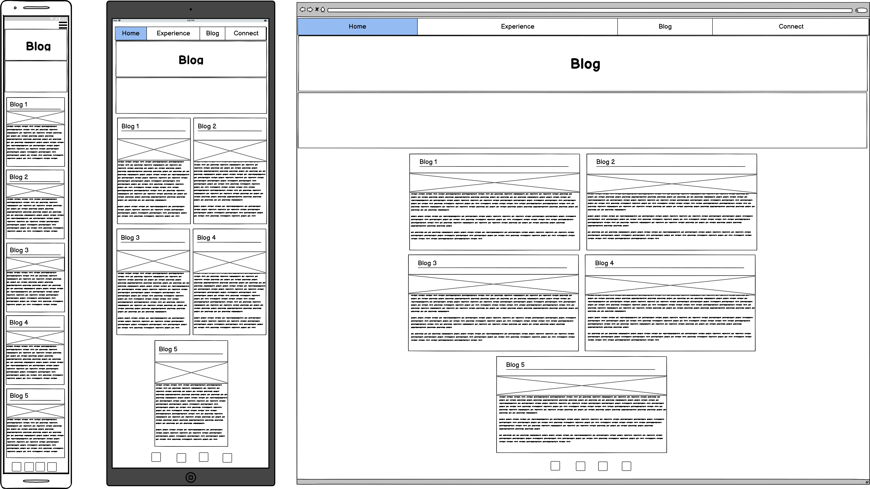
Wireframe of Blog Page

Slide 11
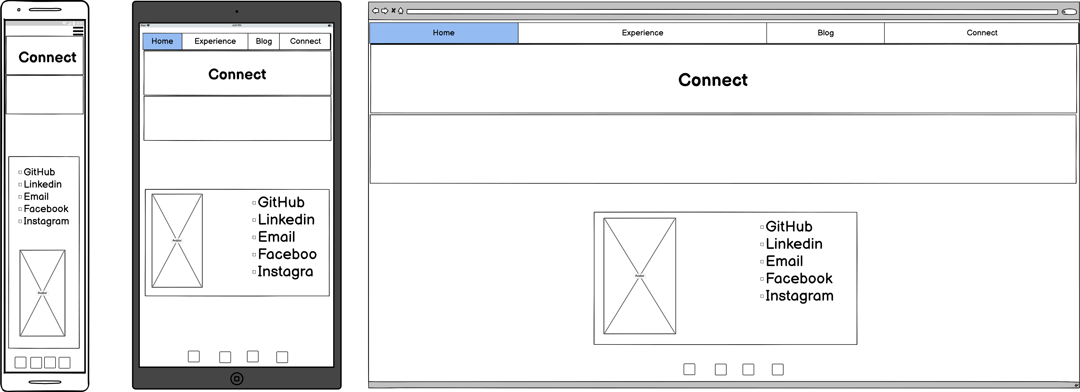
Wireframe of Connect Page

Slide 13
An overview/sitemap of all the pages on your website

Slide 14
Wireframes or mockups of the pages of your website

